Slide 1
Consistency Analysis in Bloom a CALM and Collected Approach
Presented By :
Priyanka Misra ,Tarun Patel, Nilesh Kharat, Himan Kumar Saha , Ashish Kumar ,Paras Lohani ,Vimal Patel, Tushar Kadam , Gokulnath Pillai

Slide 2
Introduction
• Distributed programming is difficult for even experienced developers to get correct.
• When it comes to high performing scalable distributed systems, coordination is a killer.
• The challenges of distribution :
Concurrency
Asynchrony
Performance variability
Partial failure
How to deal with these challenges and make distributed programming easier?

Slide 3
Existing Methods
Two Lines of approaches are available :
a) Adopting ’ACID’ properties – using serializable r/w schedules and consensus protocols
• Pros: Strong consistency guarantees
• Cons: High latency, high cost
b) Using app-specific reasoning to tolerate "loose" consistency
• Pros: More flexibility
• Cons: Hard to trust, test
Ideally, we want best of both worlds - theoretical foundations of correctness under loose consistency

Slide 4
• Key problem in distributed programming - how to deal with consistency, in the presence of temporal non-determinism? Since difficult to reason, focus is on eventual consistency.
Sufficient condition for eventual consistency - order independence
Usually a key attribute of declarative languages
Can be an issue even in them.
How do you reason about these issues - order independence and temporal non-determinism?
Using theory of relational databases and logic programming!

Slide 5
Monotonic programs
• Programs are those in which output depends only on the content of their input, not the order in which it arrives.
• With monotonicity, once we learn something to be true, no further information can come down the line later on to refute that fact.
• Monotonic code accumulates information - the more we know, the more we know.
for example : selection, projection, joins in relational algebra

Slide 6
Non –Monotonic Programs
• Non-monotonic programs are those in which the order of inputs to a program do affect the output.
• Cannot produce any output until they have received all tuples of an input set
• Non-monotonic code has belief revision - new inputs can change our mind.
For example : grouping , aggregates

Slide 7
Monotonic Program Example
• Let's look at program :
Suppose we need a function to determine whether a replicated counter’s current value is more than 10 , and further suppose that this counter can only be incremented.
Fun MoreThanTen(x: Nat) = x > 10
• the MoreThanTen function is monotone: an increase in x can cause the value of x>10 to flip from false to true, but not vice versa.
• we assume that all replicas in the system will eventually become aware of all increments that current replica is currently aware of, at which point their values will be greater than current value.
• when all replicas have received current information, every replica in the system will agree that MoreThanTen applied to the counter’s value, and returns true.

Slide 8
Non –Monotonic Example
•Finding the maximum from a set of tuples.
40
50
(Output changes from 40 to 50 )
•Non Monotonic retracts the earlier conclusion in face of new information .
10
20
30
40
MAX
10
20
30
40
50
MAX

Slide 9
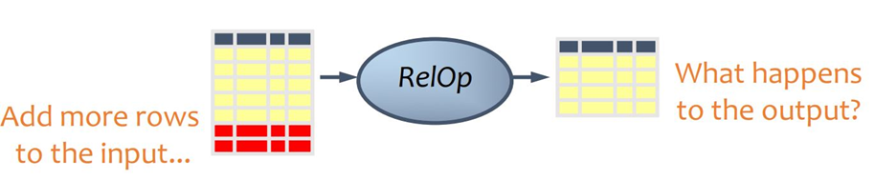
In Terms of Relational Algebra :
•If the Operator is Monotone
Old output rows will be always “valid” when more rows are added to the input.
For Example : Selection , Projection , Join Operator
•If the operator is Non –Monotone
some old output rows may need to be removed

Slide 10
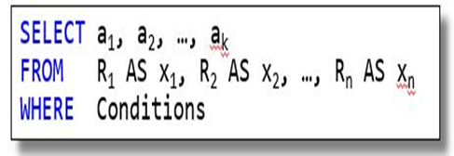
Monotonic Vs Non Monotonic
Select operator will select the desired tuples of original relation plus those new tuples which are satisfying the select condition.
Monotonic operator does not refute the existing output .

Slide 11
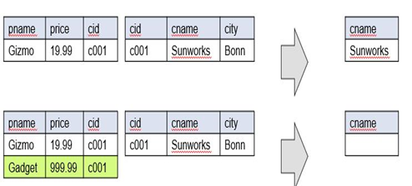
Monotonic Vs Non Monotonic
Consider the following query :
Find all companies such that all their products have price < 200
Non Monotonic operator may refute the existing output and it causes changes in the result

Slide 12
Waiting in Non –Monotonic Programs
•“Waiting” is specified in a program via coordination logic: code that
(a) computes and transmits auxiliary information from producers to enable the recipient to determine when a set has completely arrived across the network
(b) postpones production of results for consumers until after that determination is made
For Example : Finding the maximum from a set of tuples. Unless we have all the input available with us , prematurely outputting can give us erroneous results. Hence, we have to wait till all the input is available with us .
Why Waiting is undesirable?
Waiting causes latency and reduces availability.

Slide 13
Calm Principle
The CALM(Consistency As Logical Monotonicity) principle says that:
A program has a consistent, coordination-free distributed implementation if and only if it is monotonic.

Slide 14
How can we use CALM principle to aid programming for distributed systems?
• Use CALM principle to develop checks for distributed consistency in logic languages, where conservative tests for monotonicity are well-understood.
• In case when analysis can’t guarantee monotonicity, it can provide a conservative assessment of where coordination logic might be needed.
•These are called points of order.

Slide 15
Bloom
Domain specific language built over Ruby for distributed programming. Just like MATLAB over C/C++ for numeric computations.
Main purpose of Bloom
Order independence of instructions
Collection approach for data structures
CALM consistency at compile time

Slide 16
Order independence
Instructions
Traditional languages like C, C++, Java executes instructions orderly where program counter steps in.
Bloom have evaluation engine for efficient ordering of statements, which programmer have no control.
That's why Bloom is declarative language, where program semantics are clear, but how it evaluate depends on evaluation engine. Just like SQL and its execution on any database engine.
a = 20
b = 10
c = a + b
a = 20
b = 10
c = 30
Traditional languages
Possibility 1
a = 20
b = 10
c = 30
Possibility 2
b = 10
a = 20
c =30
Bloom
Bloom Statements
Evaluation Engine
Execution Plan

Slide 17
Collection approach for data structures
Coordination logic
Successful parallelized models like SQL and MapReduce have data structures as disordered collections rather than scalar variables and nested structures like lists, queues and trees.
Analogy of disordered collections suits distributed environment of disordered statements and their execution.
4
1
2
5
7
Insert tuple request into collection
From Node 1: 4
From Node 2: 7
But in Collection based approach
{1, 2, 5 }
{1, 2, 5, 4, 7 }

Slide 18

CALM consistency at compile time
Point of order : Location in the program where coordination logic is needed.
Bloom identifies point of order at compile time and guides programmer to add coordination logic.
Adding coordination logic leads to consistency.
20 students
30 students
Node 1
get student count
Node 2
Student count: 20
get student count
Student count: 50
Query: Total number of students

Slide 19
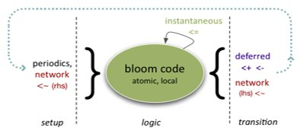
Bloom Timestep
Each node in distributed network runs an evaluator that works in a loop as in figure.
Each iteration of this loop is a timestep for that node.
Each timestep is associated with a monotonically increasing timestamp.
Timesteps and timestamps are not coordinated across nodes.
In phase 2, statements are repeatedly evaluated until a fixpoint is reached.
Phase 1
Phase 2
Phase 3
All Scratch collections are set to empty.
Statement of program are evaluated here.
Deferred operations (insert/delete) and asynchronous merge
Instantaneous merge (<=)
Deferred merge(<+) and delete(<-)
Asynchronous merge (<~)

Slide 20
Bloom Timestep Fixpoint
Fixpoint: When no new lhs items are derived from any rhs.
Instantaneous merge(<=) only adds item to collection at current timestep and doesn't delete/change anything.
Thus, all state within a Bloom timestep is immutable(loose).
For atomic update, deferred statements, one positive and one negative are executed in consecutive order.
Example:
Let, Collection c = {1,2,4,6}
Set of operation on c be:
c <= 5
c <+ 8
c <- 2
At current timestep, c = {1,2,4,6,5}
At next timestep, c = {1,4,6,5,8}
Repeateadly evaluate until
input_channel is empty
c <= input_channel
buffer <+ [[1, "newval"]] buffer <- buffer {|b| b if b.key == 1}

Slide 21
Bloom Collections
Bloom programs are bundles of declarative statements.
Statements describe collections of "facts" or tuples.
Ground facts exist in each timestep as collections.
Facts may or may not persist across timesteps.
Bloom is different than other stateful languages.
State in bloom is described by collections.

Slide 22
Bloom program
Bloom collections are declared in a "state" block as follows:
Bloom statements are specified in a function definition flagged with declared keyword with the following syntax:
def state:
<collection-type1>: <collection-variable1>, <collection-data>
…
<collection-type_n>: <collection-variable_n>, <collection-data>
end
declared
def method_name:
<collection-variable> <op> <collection-expression>
end
All of this can be packaged into a Ruby module.

Slide 23
Types of Collections
Persistent collection: table
Non-persistent collection: scratch, channel, periodic, interface.

Slide 24
table
Contents persist across timesteps until explicitly deleted. Declared as follows
table: table_name, ['key_name'], ['column_list'] //declaration
key_name is the primary key and can be collection of columns
column_list can be a list of one or more columns
scratch:
Content exists only for the current timestamp.
channel:
scratch with location specifier tagged with an "@".
periodic:
scratch collection of key-value pair. Characterized by a "period" which is in statement declaration . Tuples appear in this collection every period seconds.
periodic: timer, 10

Slide 25
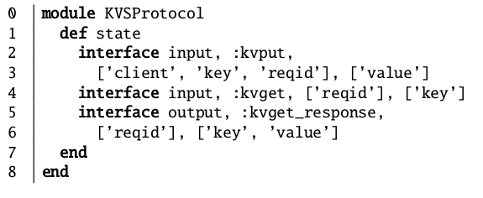
interface:
A scratch collection defined to accept from or insert tuples into another module.
Interface is of type input and output.
Usually defined in module as abstract interface.
=​ | scratch​ | Defines lhs by contents of rhs.​
<+​ | table, scratch​ | Add content of rhs to lhs in next timestep​ ​
<-​ | table​ | Remove content defined in rhs from the lhs by the beginning of next timestep​

Slide 26
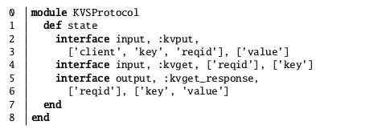
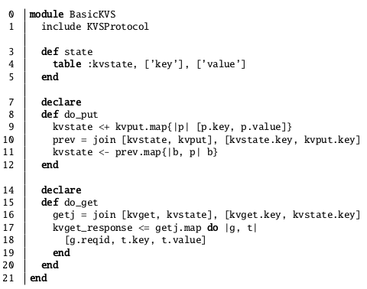
Table of key-value and operators[=, <+, <-]
Case 1(do_put): table kvstate does not contain the key
+1 timestep
LHS​(kvstate)
Key​ | Value​
1​ | Ram​
RHS(kvput.map{})
Key | Value
2 | Shyam
Kvstate after put
Key​ | Value​
1​ | Ram​
2 | Shyam

Slide 27
Table of key-value and operators[=, <+, <-]
Case 2(do_put): table kvstate contains the key
+1 timestep
LHS​(kvstate)
Key​ | Value​
1​ | Ram​
RHS(kvput.map{})
Key | Value
1 | Shyam
prev(scratch)
Key​​ | Value​​
1​​ | Ram​​
Kvstate after put
Key​ | Value​
1​ | Shyam

Slide 28
Table of key-value and operators[=, <=]
do_get: input interface kvget has key 2
in same timestep
Kvstate before get
Key​​ | Value​​
1​​ | Ram​​
2​ | Shyam​
getj(scratch) after join
Key​​ | Value​​
2​​ | Shyam
kvget_response interface
reqid | Key​​​ | Value​​​
xyz | 2​​​ | Shyam​

Slide 29
Bloom Statements
Bloom statements are declarative relational expressions that define the contents of derived collections.
They can be viewed operationally as specifying the insertion or accumulation of expression results into collections.
<collection-variable> <op> <collection-expression>
=
<=
<+
<-
<~
bc.map
bc.flat_map
bc.reduce
bc.empty?
bc.include?
bc.group
join
leftjoin
outerjoin
natjoin
table
scratch
channel
periodic
interface

Slide 30
Commonly Used Methods of BUDCollection Class
In the Bud prototype, both the lhs and rhs are instances of (a descendant of) a Ruby class called BudCollection, which supports several useful methods for manipulating collections.
The rhs of a statement typically invokes BudCollection methods on one or more collection objects to produce a derived collection.

Slide 31
bc.map:
Takes a code block and returns the collection formed by applying the code block to each element of bc.
The most commonly used method, which applies a scalar operation to every tuple in a collection; this can be used to implement relational selection and projection.
Example 1:
array = [1, 2, 3]
array.map { |n| n*2 }
# [2, 4, 6]
Example 2:
hash = [ [“bacon”, "protein"], [“apple”, "fruit"] ]
hash.map { |k,v| [k, v.upper] }
# [ [“bacon”, "PROTEIN"], [“apple”, "FRUIT"] ]

Slide 32
Example:
01 def state
02 channel :data_chan, ['@dst', 'src', 'ident'], ['payload']
03 channel :ack_chan, ['@src', 'dst', 'ident']
04 table :send_buf, ['dst', 'src', 'ident'], ['payload']
05 periodic :timer, 10
06 end
07 declare
08 def send_ack
09 ack_chan <~ data_chan.map{|p| [p.src, p.dst, p.ident]}
10 end
// here line 3 projects the data_chan collection to its src, dst, and ident fields.
data_chan
@dst | src | ident | payload
node2 | node1 | 1 | data1
node3 | node1 | 2 | data2
node4 | node1 | 3 | data3
node5 | node1 | 4 | data4
ack_chan
@src | dst | ident
node1 | node2 | 1
node1 | node3 | 2
node1 | node4 | 3
node1 | node5 | 4

Slide 33
bc.flat_map:
Equivalent to map, except that any nested collections in the result are flattened.
flattening operation:
The collection before flattening :
[ ["1", "P1", "100K"], ["2", "P2", "120K"], ["3", "P3", "80K"] ]
After Flattening, it gets transformed into “one level” structure as shown :
[ "1", "P1", "100K", "2", "P2", "120K", "3", "P3", "80K" ]

Slide 34
bc.flat_map V/s bc.map :
1) map takes a Stream and transform it to another Stream. It applies a function on each element of Stream and store return value into new Stream. It does not flatten the stream. But flat_map is the combination of a map and a flat operation i.e, it applies a function to elements as well as flatten them.
Example:
enu = [[17, 21], [19, 100]]
res1 = enu.map { |e| e + [1000] }
res2 = enu.flat_map { |e| e + [1000] }
//res1 = [ [17, 21, 1000], [19, 100, 1000] ] map
//res2 = [ 17, 21, 1000, 19, 100, 1000 ] flat_map

Slide 35
bc.reduce:
Takes a memo variable and code block, and applies the block to memo and each element of bc in turn.
It reduces a collection down to a single value by combining things.
Also worth noting is the fact that if you don’t specify an initial value for the memo, it defaults to the first element of the collection.
A popular requirement is to reduce a list of numbers into a single value by adding them together (performing a sum operation).

Slide 36
Example:
array = [1, 2, 3]
array.reduce(0) { |sum, n| sum + n }
The first time reduce is executed, sum is 0.
0 + 1 # => 1
Now, the next time it runs, the memo variable has a different value (i.e. 1), which it got from the previous iteration.
1 + 2 # => 3
And finally, the last time it runs, the value of the memo variable is 3.
3 + 3 # => 6
So the last value of the memo variable is 6, which is also the value returned by the reduce method.

Slide 37
bc.group:
BudCollection also defines a group method similar to SQL’s GROUP BY, supporting the standard SQL aggregates.
Takes a list of grouping columns, a list of aggregate expressions and a code block. For each group, computes the aggregates and then applies the code block to the group/aggregation result.

Slide 38
cart_action
session | item | action | reqid
1​​​ | book | add | 10
1 | book | add | 11
2 | shirt | remove | 13
2 | shirt | remove | 14
Example:
01 declare
02 def do_action
03 cart_action <= action_msg.map do |c|
04 [c.session, c.item, c.action, c.reqid]
05 end
06 action_cnt <= cart_action.group(
07 [cart_action.session, cart_action.item, cart_action.action],
08 count(cart_action.reqid))
09 end
// here lines 6–8 compute the count of unique reqid values for every combination of values for session, item and action.
action_count
session | item | action | count
1​​​ | book | add | 2
2 | shirt | remove | 2

Slide 39
join:
Method of the Bud class to compute join variants over BudCollections.
Mainly of 4 types: Join, leftjoin, outerjoin and natjoin.
Join, leftjoin and outerjoin take an array of collections to join, as well as a variable-length list of arrays of join conditions.
The natural join natjoin takes only the array of BudCollection objects as an argument.

Slide 40
Kvstate
Key​​​ | Value​​​
1​​​ | Ram​​​
2​​ | Shyam​​
Kvput
Key​​​ | Value​​​
1​​​ | Ram
3 | Rahul
prev
Key​​​ | Value​​​
1​​​ | Ram​​​
Example:
01 def do_put
02 kvstate <+ kvput.map{|p| [p.key, p.value]}
03 prev = natjoin [kvstate, kvput]
04 kvstate <- prev.map{|b, p| b}
05 end

Slide 41
Other BudCollection methods :
Method | Description
bc.empty? | Returns true if bc is empty
bc.include? | Takes an object and returns true if that object is equal to any element of bc.

Slide 42
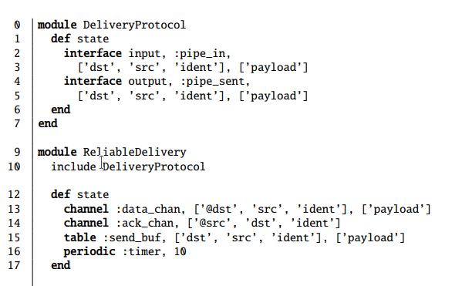

…
Bloom Statements
...

Slide 43
1
Module ReliableDelivery
Module ReliableDelivery
pipe_in (interface)
pipe_in
Input
dst | src | ident | payload
dst | src | ident | payload
send_buf (table)
send_buf
dst | src | ident | payload
@dst | src | ident | payload
data_chan (channel)
data_chan
data_chan
@dst | src | ident | payload
@dst | src | ident | payload
ack_chan (channel)
ack_chan
ack_chan
@src | dst | ident
@src | dst | ident
timer, 10 (periodic)
timer, 10
id | clock
id | clock
pipe_sent (interface)
pipe_sent
Output
dst | src | ident | payload
dst | src | ident | payload
Node1
Node2

Slide 44
1
pipe_in
<= : include rhs content in lhs in current timestamp
<~ : rhs content appears in (remote) lhs in future
dst | src | ident | payload
node2 | node1 | 1 | data
pipe_in
dst | src | ident | payload
send_buf
send_buf
dst | src | ident | payload
node2 | node1 | 1 | data
dst | src | ident | payload
dst | src | ident | payload
data_chan
data_chan
Input
data_chan
@dst | src | ident | payload
ack_chan
@dst | src | ident | payload
ack_chan
ack_chan
send_buf <= pipe_in
data_chan <~ pipe_in
@src | dst | ident
@src | dst | ident
Output
timer, 10
timer, 10
id | clock
id | clock
pipe_sent
pipe_sent
dst | src | ident | payload
dst | src | ident | payload
Node1
Node2

Slide 45
4
3
2
pipe_in
pipe_in
<= : include rhs content in lhs in current timestamp
<~ : rhs content appears in (remote) lhs in future
dst | src | ident | payload
dst | src | ident | payload
send_buf
send_buf
dst | src | ident | payload
dst | src | ident | payload
node2 | node1 | 1 | data
data_chan
@dst | src | ident | payload
@dst | src | ident | payload
node2 | node1 | 1 | data
data_chan
data_chan
Input
@dst | src | ident | payload
ack_chan
ack_chan
ack_chan
send_buf <= pipe_in
@src | dst | ident
@src | dst | ident
data_chan <~ pipe_in
Output
timer, 10
timer, 10
id | clock
id | clock
pipe_sent
pipe_sent
dst | src | ident | payload
dst | src | ident | payload
Node1
Node2

Slide 46
4
pipe_in
pipe_in
bc.map : apply code block to each tupple in collection `bc' and returns resulting collection
dst | src | ident | payload
dst | src | ident | payload
send_buf
send_buf
dst | src | ident | payload
dst | src | ident | payload
node2 | node1 | 1 | data
data_chan
@dst | src | ident | payload
node2 | node1 | 1 | data
data_chan
data_chan
Input
@dst | src | ident | payload
ack_chan
ack_chan
ack_chan
@src | dst | ident
send_buf <= pipe_in
@src | dst | ident
data_chan <~ pipe_in
Output
timer, 10
ack_chn <~ data_chan.map{|p| [p.src, p.dst, p.ident]}
timer, 10
id | clock
id | clock
pipe_sent
pipe_sent
dst | src | ident | payload
dst | src | ident | payload
Node1
Node2

Slide 47
7
6
5
pipe_in
send_buf
= : content of rhs is copied to lhs for current timestamp
<- : tupple in rhs not present in lhs in beginning of next timestamp
join : compute join over array of collection.
dst | src | ident | payload
node2 | node1 | 1 | data
dst | src | ident | payload
send_buf
data_chan
dst | src | ident | payload
@dst | src | ident | payload
data_chan
ack_chan
@dst | src | ident | payload
@src | dst | ident
node1 | node2 | 1
data_chan
Input
@src | dst | ident
ack_chan
ack_chan
got_ack
@src | dst | ident
ack_chan | send_buf
{node1, node2, 1} | {node2, node1, 1, data}
send_buf <= pipe_in
ack_chan | send_buf
data_chan <~ pipe_in
Output
ack_chn <~ data_chan.map{|p| [p.src, p.dst, p.ident]}
timer, 10
timer, 10
id | clock
got_ack = join [ack_chan, send_buf], [ack_chan.ident, send_buf.ident]
pipe_sent
id | clock
pipe_sent
pipe_sent <= got_ack.map{|a, sb| sb}
dst | src | ident | payload
dst | src | ident | payload
send_buf <- got_ack.map{|a, sb| sb}
dst | src | ident | payload
node2 | node1 | 1 | data
Node1
Node2

Slide 48
8
pipe_in
send_buf
= : content of rhs is copied to lhs for current timestamp
<- : tupple in rhs not present in lhs in beginning of next timestamp
join : compute join over array of collection.
dst | src | ident | payload
dst | src | ident | payload
send_buf
data_chan
dst | src | ident | payload
@dst | src | ident | payload
data_chan
ack_chan
@dst | src | ident | payload
Input
@src | dst | ident
data_chan
ack_chan
ack_chan
got_ack
@src | dst | ident
send_buf <= pipe_in
ack_chan | send_buf
data_chan <~ pipe_in
Output
ack_chn <~ data_chan.map{|p| [p.src, p.dst, p.ident]}
timer, 10
timer, 10
id | clock
got_ack = join [ack_chan, send_buf], [ack_chan.ident, send_buf.ident]
pipe_sent
id | clock
pipe_sent
pipe_sent <= got_ack.map{|a, sb| sb}
dst | src | ident | payload
dst | src | ident | payload
send_buf <- got_ack.map{|a, sb| sb}
Node1
Node2

Slide 49
11
pipe_in
dst | src | ident | payload
node2 | node1 | 2 | data
pipe_in
dst | src | ident | payload
send_buf
send_buf
dst | src | ident | payload
node2 | node1 | 1 | data
dst | src | ident | payload
dst | src | ident | payload
data_chan
data_chan
Input
data_chan
@dst | src | ident | payload
ack_chan
@dst | src | ident | payload
ack_chan
ack_chan
send_buf <= pipe_in
@src | src | ident
@src | dst | ident
data_chan <~ pipe_in
Output
timer, 10
ack_chn <~ data_chan.map{|p| [p.src, p.dst, p.ident]}
timer, 10
id | clock
id | clock
got_ack = join [ack_chan, send_buf], [ack_chan.ident, send_buf.ident]
pipe_sent
pipe_sent
dst | src | ident | payload
pipe_sent <= got_ack.map{|a, sb| sb}
dst | src | ident | payload
send_buf <- got_ack.map{|a, sb| sb}
Node1
Node2

Slide 50
12
11
13
19
20
pipe_in
dst | src | ident | payload
pipe_in
dst | src | ident | payload
send_buf
send_buf
dst | src | ident | payload
node2 | node1 | 2 | data
dst | src | ident | payload
data_chan
data_chan
Input
data_chan
@dst | src | ident | payload
ack_chan
@dst | src | ident | payload
ack_chan
ack_chan
send_buf <= pipe_in
@src | dst | ident
@src | dst | ident
data_chan <~ pipe_in
Output
timer, 10
ack_chn <~ data_chan.map{|p| [p.src, p.dst, p.ident]}
timer, 10
id | clock
t2 | 20
data_chan <~ join([send_buf, timer]).map{|p, t| p}
id | clock
got_ack = join [ack_chan, send_buf], [ack_chan.ident, send_buf.ident]
pipe_sent
pipe_sent <= got_ack.map{|a, sb| sb}
dst | src | ident | payload
pipe_sent
send_buf <- got_ack.map{|a, sb| sb}
dst | src | ident | payload
Node1
Node2

Slide 51
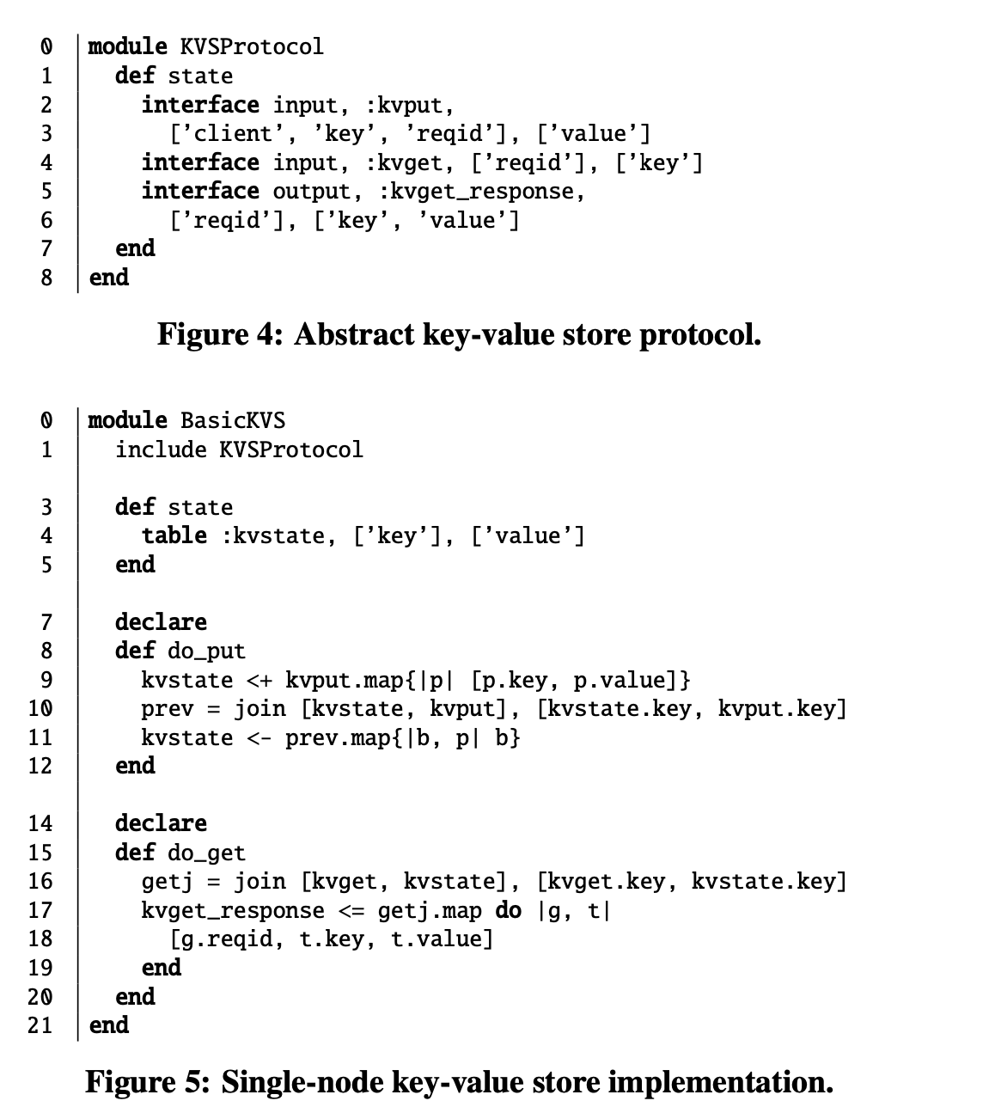
Dry run of BasicKVS
This module provides two input interfaces for clients to send request.
Kvput is be used to store key, value pair
Kvget is used to request value corresponding a key
Response of kvget request is send by output interface kvget_response

Slide 52
Dry run of BasicKVS
State
This module provides two input interfaces for clients to send request.
Kvput is be used to store key, value pair
Kvget is used to request value corresponding a key
Response of kvget request is send by output interface kvget_response
Rules

Slide 53
2
Module BasicKVS
1
kvput (interface)
Input
kvstate <+ kvput.map{|p| [p.key, p.value] }
client | key | reqid | value
client | key | reqid | value
user1 | k1 | r1 | PoDS
prev = join [kvstate, kvput], [kvstate.key, kvput.key]
kvget (interface)
Input
kvstate <- prev.map{|b, p| b}
reqid | key
kvstate (table)
key | value
prev (scratch)
kvstate | kvput
kvresponse (interface)
Output
reqid | key | response

Slide 54
4
Module BasicKVS
3
kvput (interface)
Input
kvstate <+ kvput.map{|p| [p.key, p.value] }
client | key | reqid | value
client | key | reqid | value
user1 | k1 | r2 | CALM
prev = join [kvstate, kvput], [kvstate.key, kvput.key]
kvget (interface)
kvstate <- prev.map{|b, p| b}
Input
reqid | key
kvstate (table)
key | value
k1 | PoDS
prev (scratch)
prev (scratch)
kvstate | kvput
<k1, PoDS> | <user1, k1, r2, CALM>
kvstate | kvput
kvresponse (interface)
Output
reqid | key | response

Slide 55
5
Module BasicKVS
kvput (interface)
Input
kvstate <+ kvput.map{|p| [p.key, p.value] }
client | key | reqid | value
prev = join [kvstate, kvput], [kvstate.key, kvput.key]
kvget (interface)
kvstate <- prev.map{|b, p| b}
Input
reqid | key
kvstate (table)
key | value
k1 | PoDS
k1 | CALM
prev (scratch)
kvstate | kvput
kvresponse (interface)
Output
reqid | key | response

Slide 56
6
Module BasicKVS
kvput (interface)
Input
kvstate <+ kvput.map{|p| [p.key, p.value] }
client | key | reqid | value
prev = join [kvstate, kvput], [kvstate.key, kvput.key]
kvget (interface)
kvstate <- prev.map{|b, p| b}
Input
reqid | key
r3 | k1
reqid | key
getj = join [kvget, kvstate], [kvget.key, kvstate.key]
kvstate (table)
kvget_response <= getj.map do |g, t|
[g.reqid, t.key, t.value]
end
key | value
k1 | CALM
getj (scratch)
kvget | kvstate
<r3, k1> | <k1, CALM>
kvresponse (interface)
Output
reqid | key | response
r3 | k1 | CALM
reqid | key | response

Slide 57
7
Module BasicKVS
kvput (interface)
Input
kvstate <+ kvput.map{|p| [p.key, p.value] }
client | key | reqid | value
prev = join [kvstate, kvput], [kvstate.key, kvput.key]
kvget (interface)
kvstate <- prev.map{|b, p| b}
Input
reqid | key
reqid | key
getj = join [kvget, kvstate], [kvget.key, kvstate.key]
kvstate (table)
kvget_response <= getj.map do |g, t|
[g.reqid, t.key, t.value]
end
key | value
k1 | CALM
getj (scratch)
kvget | kvstate
kvresponse (interface)
Output
reqid | key | response

Slide 58
12
Module BasicKVS
kvget (interface)
Input
reqid | key
r10 | k1
r11 | k1
r12 | k2
reqid | key
kvstate <+ kvput.map{|p| [p.key, p.value] }
prev = join [kvstate, kvput], [kvstate.key, kvput.key]
kvstate <- prev.map{|b, p| b}
kvstate (table)
key | value
k1 | CALM
k2 | 25
getj = join [kvget, kvstate], [kvget.key, kvstate.key]
kvget_response <= getj.map do |g, t|
[g.reqid, t.key, t.value]
end
getj (scratch)
kvget | kvstate
<r10, k1> | <k1, CALM>
<r11, k1> | <k1, CALM>
<r12, k2> | <k2, 25>
kvget | kvstate
kvresponse (interface)
Output
reqid | key | response
reqid | key | response
r10 | k1 | CALM
r11 | k1 | CALM
r12 | k2 | 25

Slide 59
13
Module BasicKVS
kvget (interface)
Input
reqid | key
kvstate <+ kvput.map{|p| [p.key, p.value] }
prev = join [kvstate, kvput], [kvstate.key, kvput.key]
kvstate <- prev.map{|b, p| b}
kvstate (table)
key | value
k1 | CALM
k2 | 25
getj = join [kvget, kvstate], [kvget.key, kvstate.key]
kvget_response <= getj.map do |g, t|
[g.reqid, t.key, t.value]
end
getj (scratch)
kvget | kvstate
kvresponse (interface)
Output
reqid | key | response

Slide 60
Modules Interfaces

Slide 61
Modules
Bloom uses object-oriented features
Program broken in modules, and they interact among themselves

Slide 62
Mixin
Including other modules collections and statements
“include” statement is used

Slide 63
Interface
Collection provided by bloom

Slide 64
Interface
Input interface accepts prompts from another module
Same prompt will appear in output interface after one timestamp

Slide 65
Override
Bloom supports overriding the interface
To reuse existing modules and interpose additional logic

Slide 66
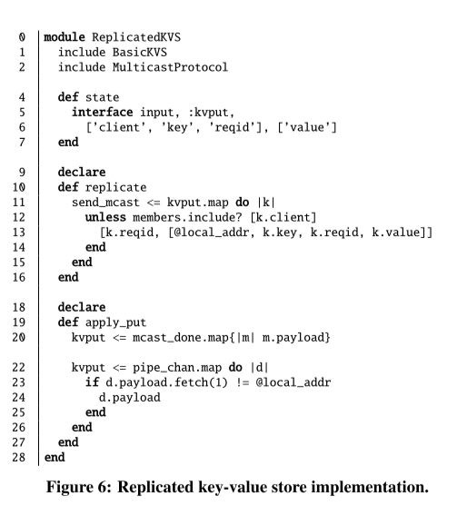
Replicated Key-Value Store
Multiple instance of key-value store
Uses multicast protocol
Multicast protocol uses best effort delivery protocol

Slide 67
Replicated Key-Value Store
Simplified code
send_mcast <= kvput.map
do |k|
unless members.include? [k.client]
[k.reqid, [@local_addr, k.key, k.reqid, k.value]]
end
end
kvput <= mcast_done.map{|m| m.payload}
kvput <= pipe_chan.map do |d|
if d.payload.fetch(1) != @local_addr
d.payload
end
end

Slide 68
Replicated Key-Value Store
Simplified code
send_mcast <= kvput.map
do |k|
unless members.include? [k.client] //check if this is a multicast
[k.reqid, [@local_addr, k.key, k.reqid, k.value]]
end
end
Initiator node multicasts
Multicasts all the input tuple received at kvput interface
send_mcast is an input interface of multicast module
Anything written to send_mcast will get received by all other members of group
kvput <= mcast_done.map{|m| m.payload}
kvput <= pipe_chan.map do |d|
if d.payload.fetch(1) != @local_addr
d.payload
end
end

Slide 69
Replicated Key-Value Store
Simplified code
send_mcast <= kvput.map
do |k|
unless members.include? [k.client]
[k.reqid, [@local_addr, k.key, k.reqid, k.value]]
end
end
Logic for the initiator node
When the multicast by some node (let say node1) has been reached to every other node, the corresponding tuple appears into mcast_done (at node1)
Once multicasts get completed the source node stores key-value pair into kvstate
kvput <= mcast_done.map{|m| m.payload} //after multicast write into local store
kvput <= pipe_chan.map do |d|
if d.payload.fetch(1) != @local_addr
d.payload
end
end

Slide 70
Replicated Key-Value Store
Simplified code
send_mcast <= kvput.map
do |k|
unless members.include? [k.client]
[k.reqid, [@local_addr, k.key, k.reqid, k.value]]
end
end
Logic for non-initiator nodes
Insert a key-value pair received from multicast into local key-value store instance
kvput <= mcast_done.map{|m| m.payload}
kvput <= pipe_chan.map do |d|
if d.payload.fetch(1) != @local_addr
d.payload
end
end
// insert a request received from multicast into local store

Slide 71
Problems with replicated key-value store
Node 1
Node 2
Insert(key_1, val_1)
1
Solution
Attach a timestamp with each request
Use timestamp to coordinate multiple inserts
For example in this case the insert(key_1, val_1) will have timestamp 1 and therefore node 2 will simply ignore it
2
Insert(key_1, val_2)
3
Multicast of insert(key_1, val_1)

Slide 72
Predicate Dependency Graphs

Slide 73
Bloom program will be converted to a data flow graph.
Collections -> nodes
Rules -> edges
External input interface -> source
Internal input interface -> sink

Slide 74
Symbols and Annotations

Slide 75

Node
Ephemeral collections like Scratch, periodic, channel

Slide 76

Node
Tables (kvstate)

Slide 77
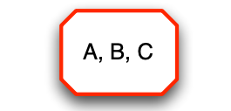
Node
Cluster of collections
Temporal cluster, which is single non-monotonic node in the graph

Slide 78
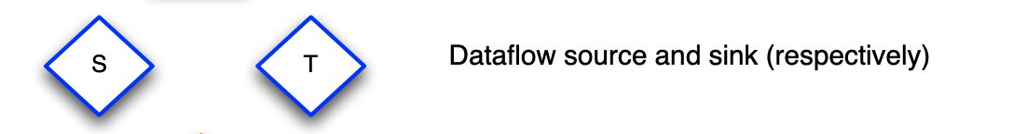
Node

Slide 79

Node

Slide 80

Edge
kvget_response <= getj.map do |g, t| [g.reqid, t.key, t.value]

Slide 81
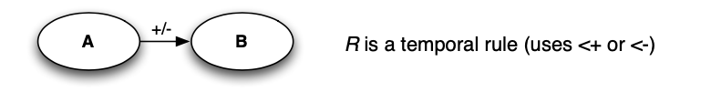
Edge
kvstate <+ kvput.map{|p| [p.key, p.value]}

Slide 82
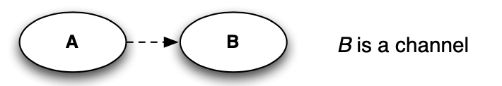
Edge

Slide 83
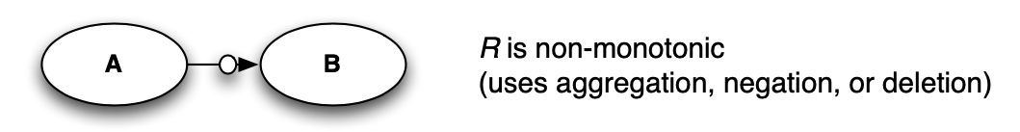
Edge

Slide 84
Analysis

Slide 85
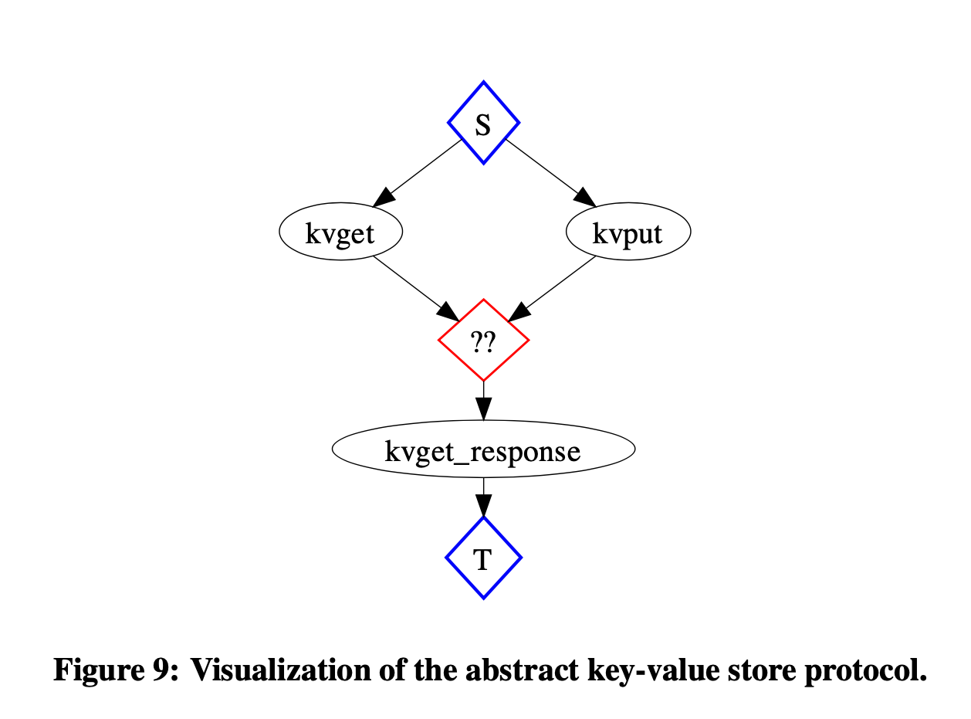
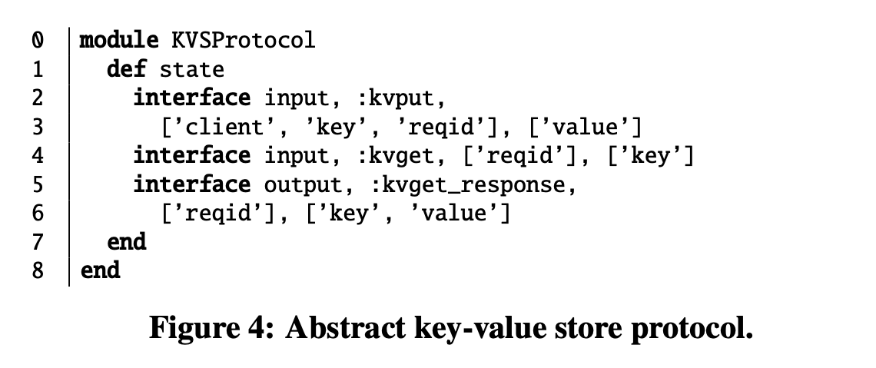
Abstract key value store protocol

Slide 86
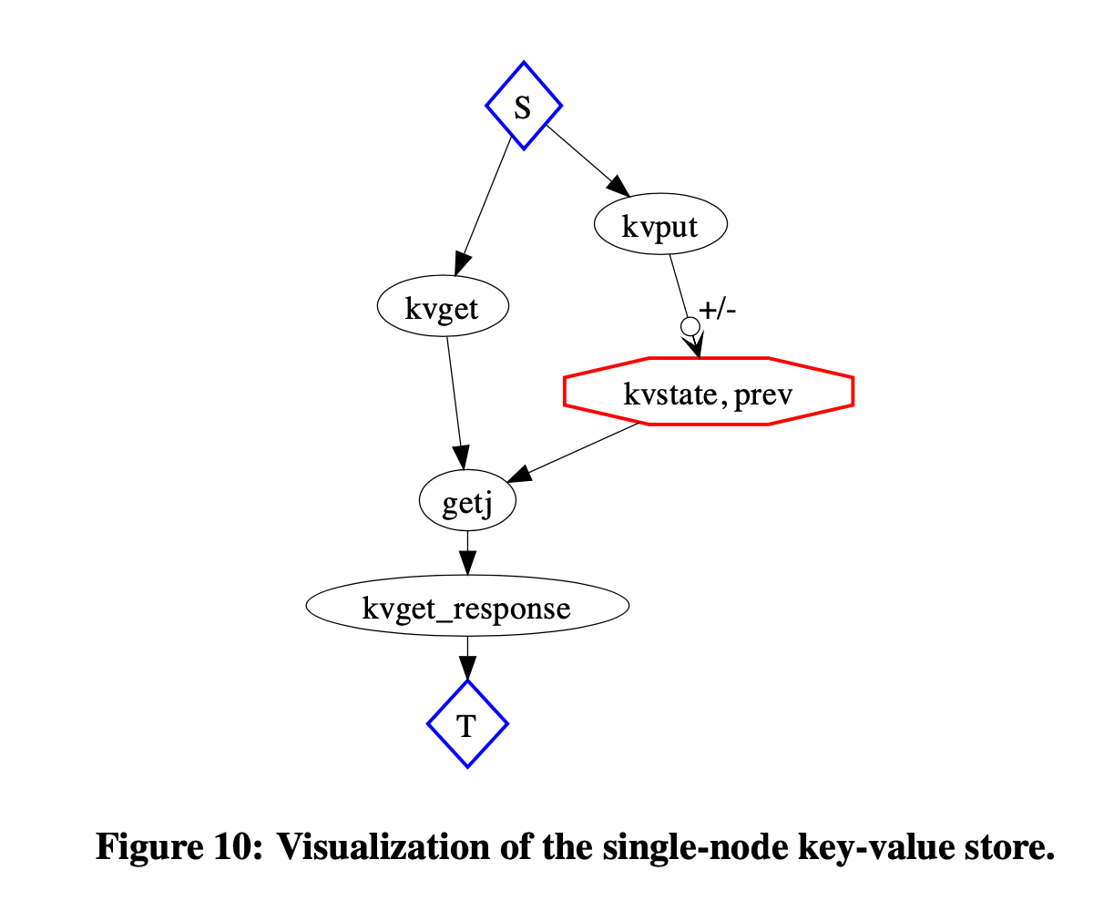
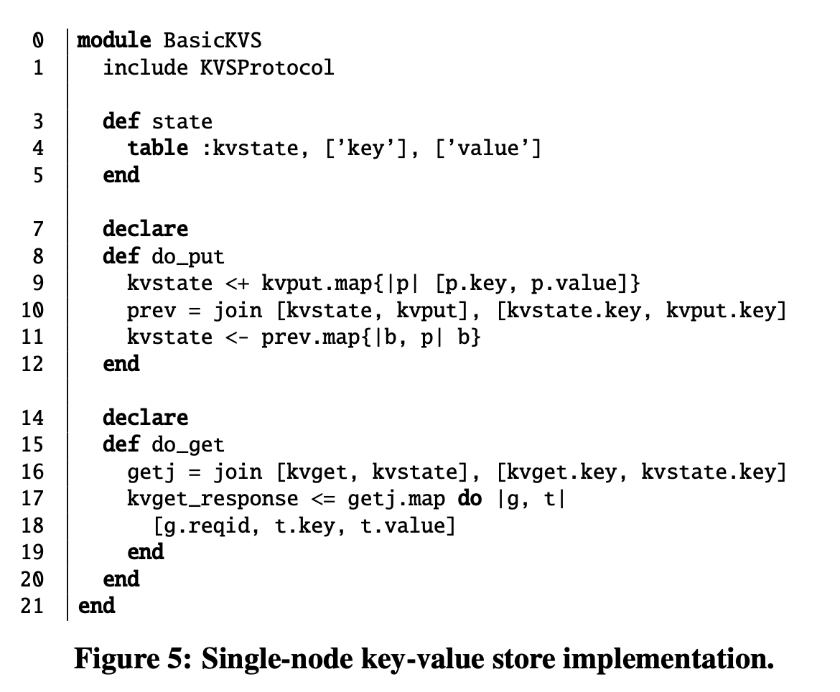
Single node key value store

Slide 87
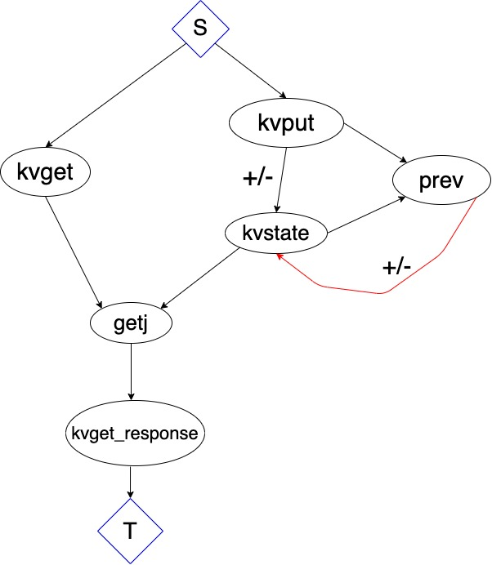
Single node key value store

Slide 88
Case Study : Shopping Cart
Expected functionality
Clients add and remove items from their carts.
Content of cart is stored in server replica.
Client can perform checkout which returns final state of cart.

Slide 89
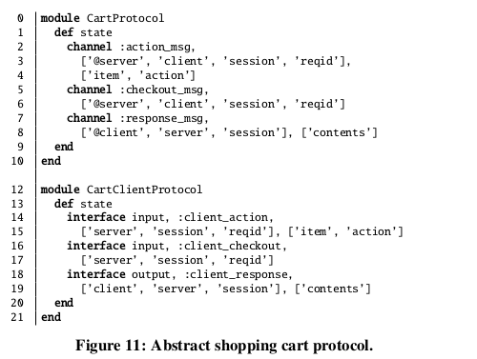
5.1 Shopping cart Client
Channels used for communication
Interfaces for client actions and responses

Slide 90
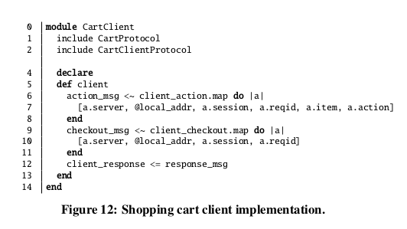
Client Implementation of Cart
Note the usage of tilde operator here!
Used to receive response sent by server-side cart

Slide 91
Server Side Cart Implementation
Two implementations of Cart
A) Destructive cart – Includes State-Modifying cart service which uses key-values store
B) Disorderly carts – Updates are monotonically accumulated in a set, summed up only at checkouts.

Slide 92
Destructive Shopping Cart Service
Each cart is stored as a (key,value) pair
Key = unique session id
Value = contains session state and array that holds items in cart.
Adding or deleting items is "destructive" in nature i.e. they happen by overwriting the values.

Slide 93
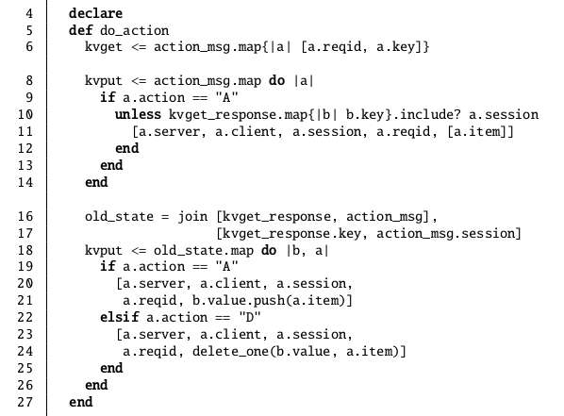
action_msg receives action from Client.
Check is performed if record exists for client's session; if not, entry is generated
Since record already present, depending on the action specified by client,
update the cart.

Slide 94
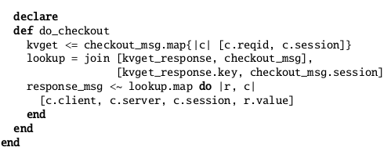
Destructive Cart – Checkout Implementation
(Find join of
kvget_response
and checkout_msg)
(Send response to Client
via response_msg)

Slide 95
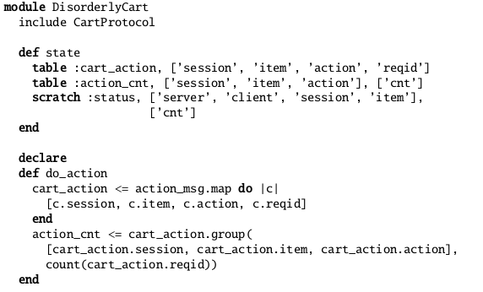
Disorderly Cart Implementation – do_action
Cart_action is used to store all actions sent by user.
For each item in a cart, we count the number of times it was added and deleted and store it in action_cnt.

Slide 96
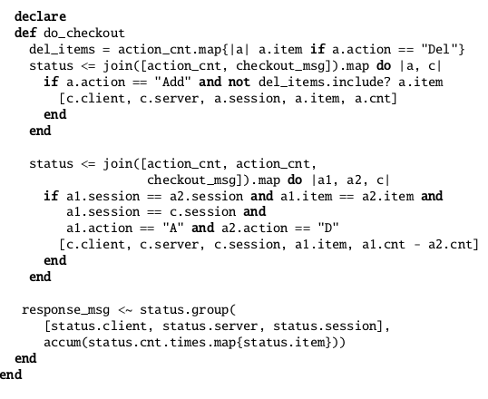
Disorderly Cart Implementation - Checkout
Here, status stores record of every item for which there was no corresponding delete in the session.
Here, status stores the record of items which have both additions and deletions. For each item, status contains its final quantity: the difference between the number of additions and deletions.
Response which is sent to Client.

Slide 97
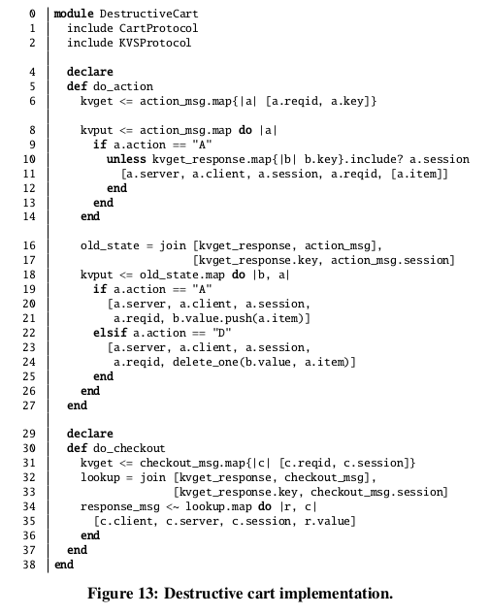
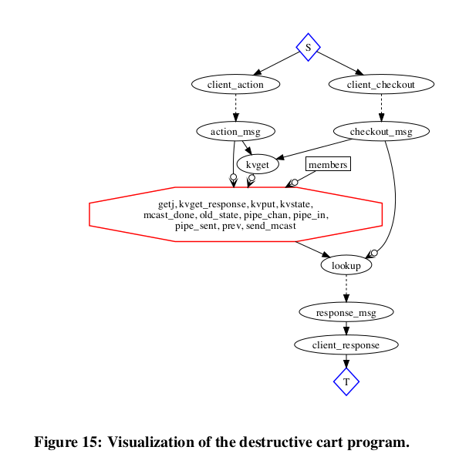
5.4 Analysis: Destructive Cart

Slide 98
5.4 Analysis: Non-monotonic edges
Client Interfaces to access cart
Because of kvput
Octagon representing strongly connected component with non-monotonic edges
Temporal cluster : Key-value store uses <- operator which is non-monotonic.

Slide 99
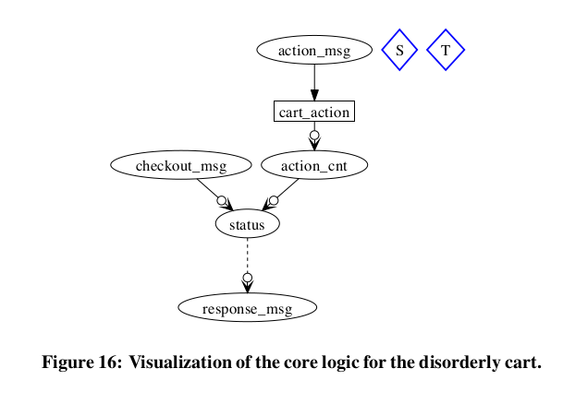
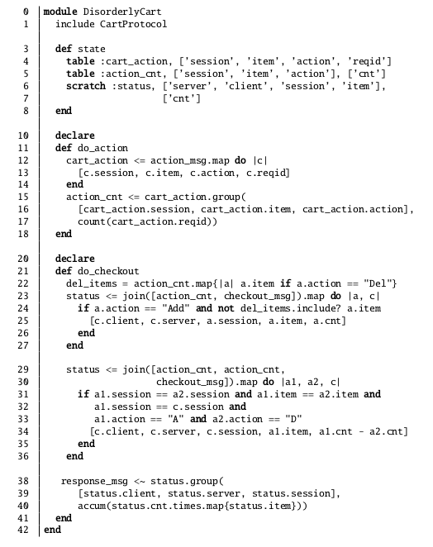
Disorderly Shopping cart service

Slide 100


Disorderly cart – non-monotonic edges
Group aggregation
Addition of new actions can change status
Summarization of cart state required co-ordination logic
Accum Aggregation

Slide 101
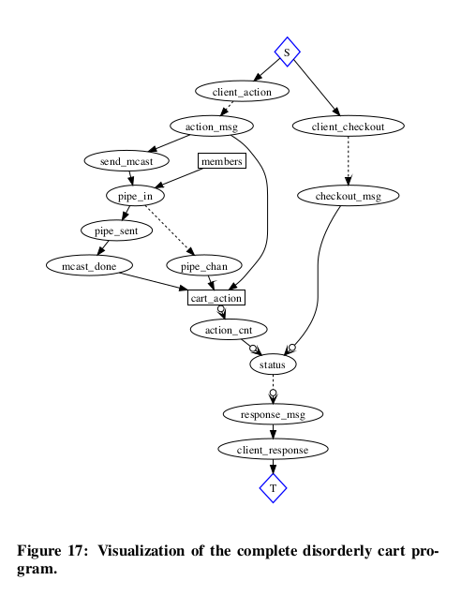


Maintaining Cart_action on multiple nodes
Summarization of cart state required co-ordination logic
Count aggregation
Accum Aggregation

Slide 102
5.5 Discussion
Occurrence strict monotonic programs in code is rare.
Both implementation have points of order but with different relative coordination costs
Requirement of Domain knowledge for finding other implementations
Bloom encourages a style of programming that minimizes coordination requirements – providing set of order-independent abstractions.
Given implementations with points of order -Bloom's data flow analysis helps developers iteratively refine their program

Slide 103
Thank you.

